Slide 1



Security Best Practices & Cost optimization

Slide 2
AGENDA
Security Practices – GKE
Security Practices – Compute Engine
Cost Optimization – GKE
Cost Optimization – Compute Engine
Compute Engine Scheduling
Demo

Slide 3
Security Best Practices
GKE Private cluster for Commerce project products
Google provides below three options to create private GKE cluster based on our use case,
we have tested this options with commerce 918 and everything works fine as same as public GKE cluster.
Public endpoint access disabled
Public endpoint access enabled with authorized networks
Public endpoint access enabled
Compute Engine VMs without external IP
Uses NAT for internet access
Uses IAP ssh and IAP desktop to connect to the resources

Slide 4
Security Best Practices
Use customized VPC
Use non-default VPC, commerce-vpc-network for commerce project.
Firewall Rules – for required sources/destinations only
Create firewall rule for the specific IP and ports
Create f/w rule with tags and not with “apply to all instances”
IAP Desktop for RDP session

Slide 5
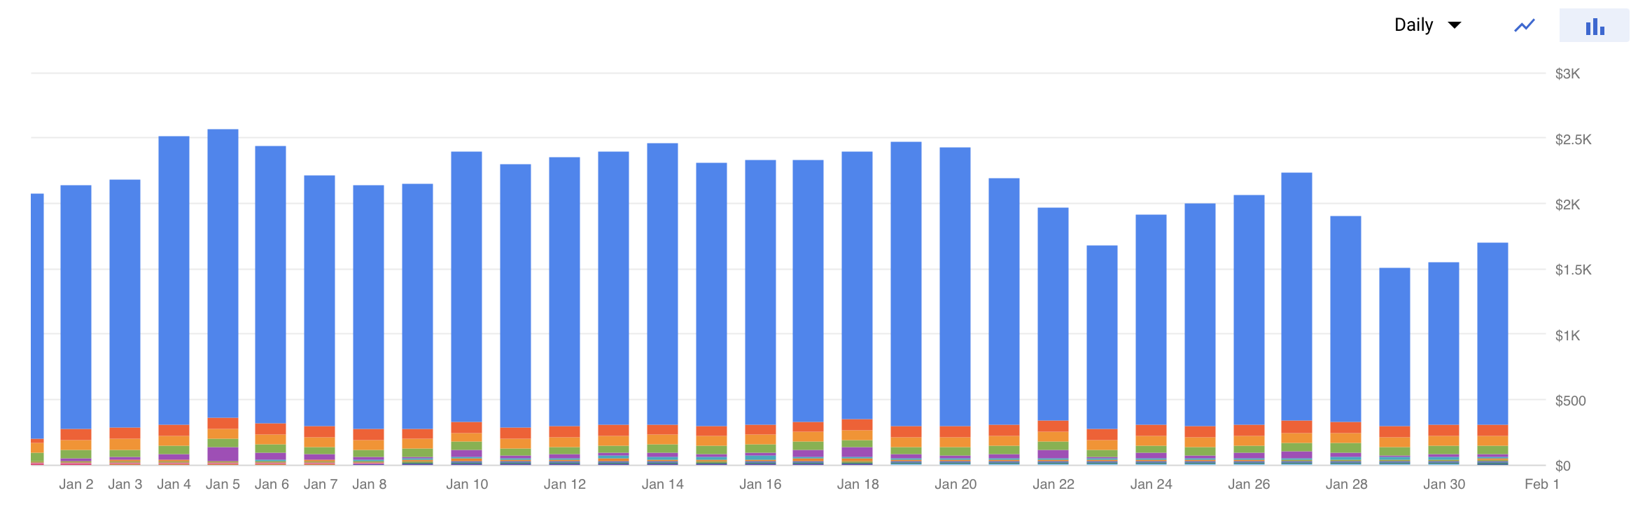
Cost optimization
GKE Cluster nodes
Compute Engine VMs

Slide 6
Example GKE Cluster cost
http listener
(single)
10 X Instance type: e2-standard-16 (16 CPU, 64GB RAM) X 24/7 X 30 - USD 3,913.47
Weekend scale down
10 X Instance type: e2-standard-16 (16 CPU, 64GB RAM) X 24/5 X 22 - USD 2,795.33
Scale down during non-business hours
10 X Instance type: e2-standard-16 (16 CPU, 64GB RAM) X 12/5 X 22 - USD 1,397.67
Preemptible VM instances pool
10 X Instance type: e2-standard-16 (16 CPU, 64GB RAM) X 12/5 X 22 - USD 419.30
Up to 90% reduction on total cost possible for GKE Cluster
Commerce Cluster (single)
OneDB Master
Primary
(active)
OneDB
Secondary
(passive)
Notes:
Preemptible VM instances are available at much lower price—a 60-91% discount
preemptible VMs can only run for up to 24 hours at a time

Slide 7
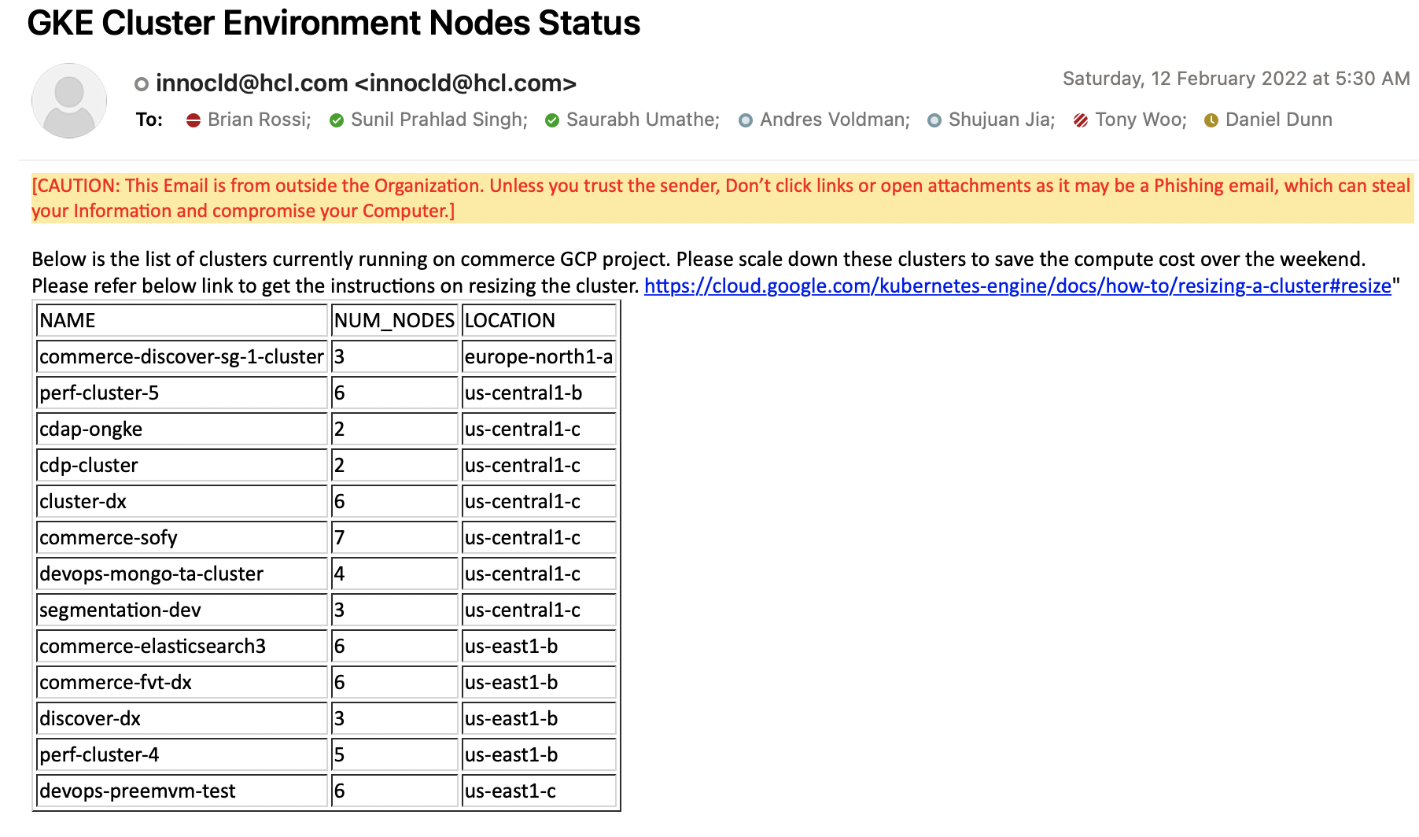
Email notification to scale down node pool

Slide 8

Example of Compute Engine VM cost
1 X Instance type: e2-standard-8 (8 CPU, 32GB RAM) X 24/7 X 30 - USD 468.31
Stop VM during weekend
1 X Instance type: e2-standard-8 (8 CPU, 32GB RAM) X 24/5 X 22 - USD 335.65
Stop during non-business hours
1 X Instance type: e2-standard-8 (8 CPU, 32GB RAM) X 12/5 X 22 - USD 169.83
Up to 64% reduction on total cost possible
Notes:
Preemptible VMs can be used to create normal VM as well if our use case says to run for up to 24 hours at a max time

Slide 9
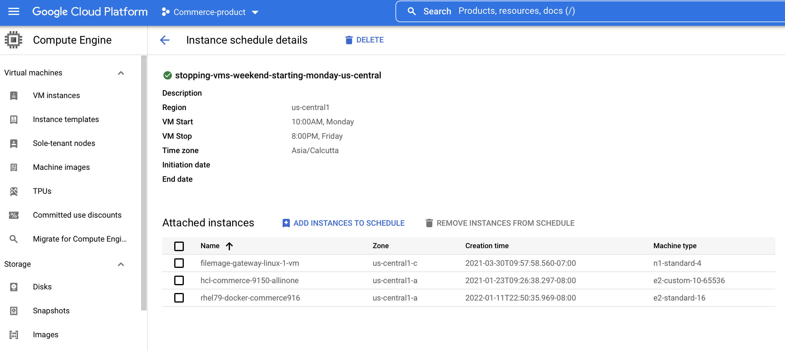
Compute Instance Schedule

Slide 10
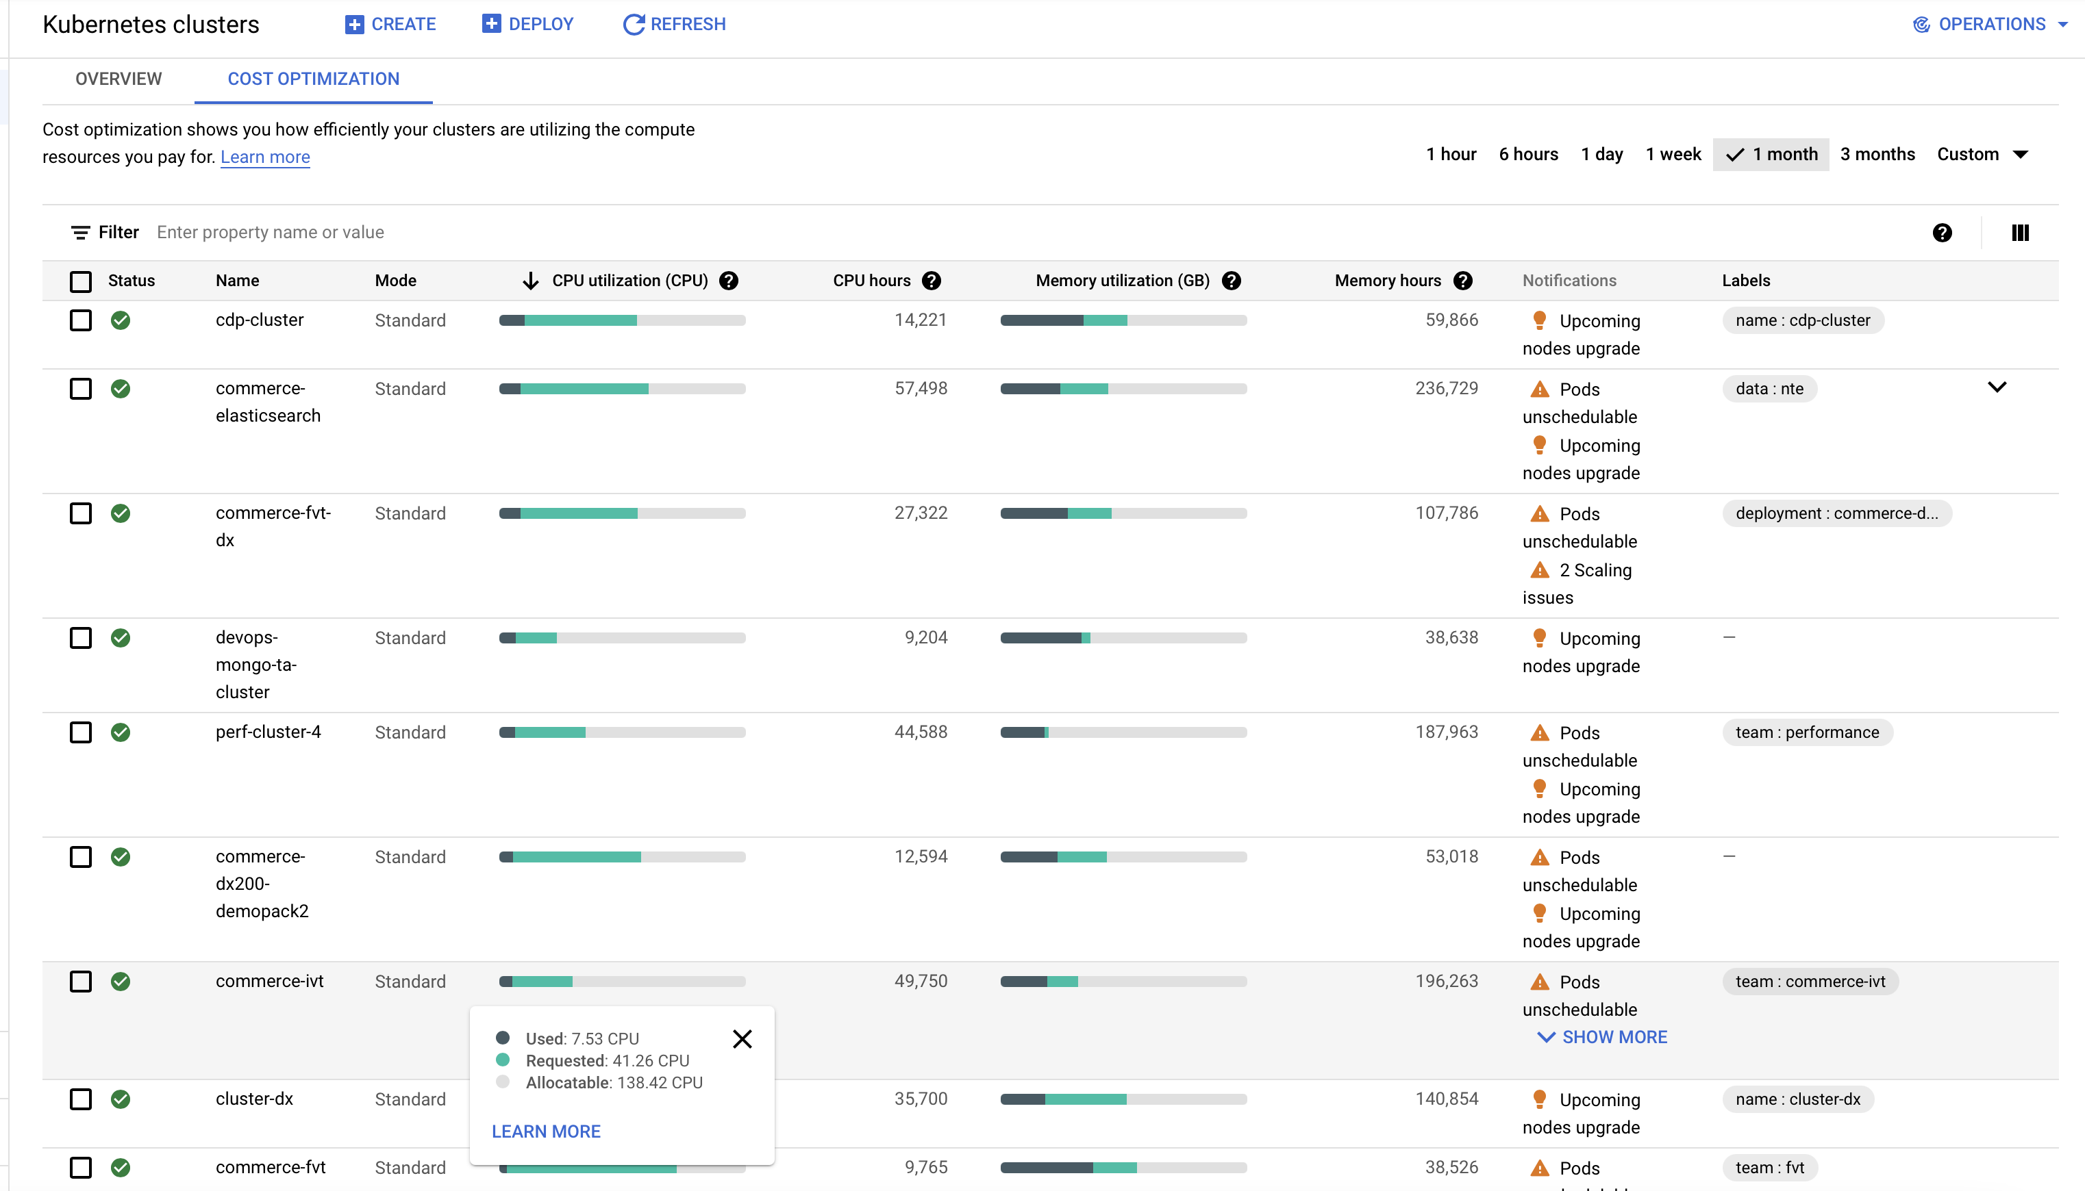
Cost optimization tab

Slide 11
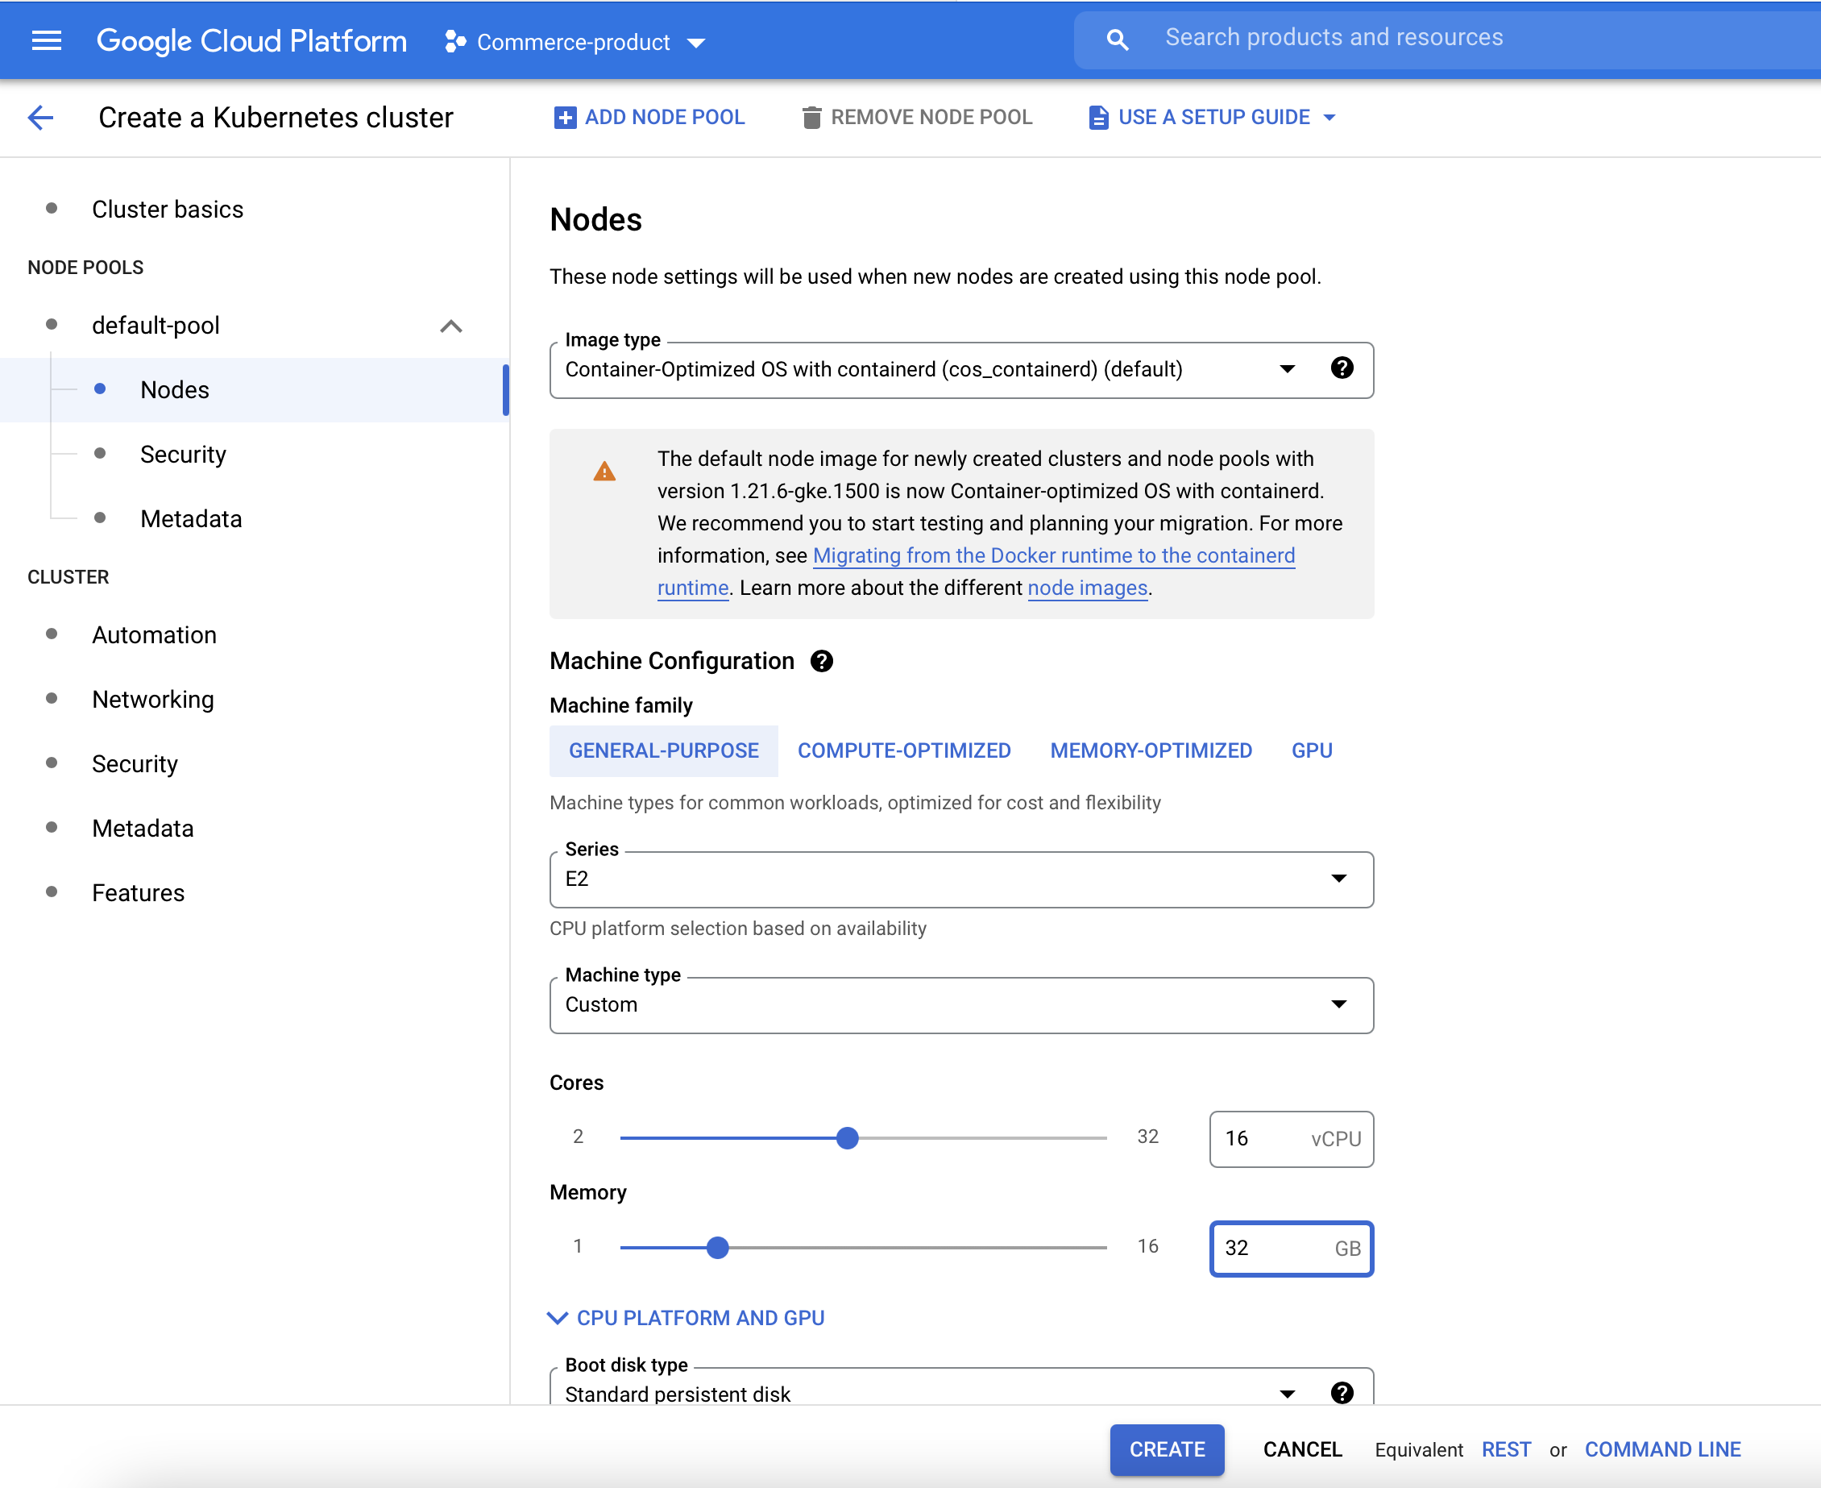
Custom Machine Type

Slide 12
Expectation from Team Owner
Security best practices
Create only Private GKE Cluster going forward
Migrate/Re-create existing GKE into Private cluster
Create Compute Engine VM without external IP
Use commerce-vpc-network instead of default VPC
Any new firewall rules creation/modification reach out to DevOps team
Cost Optimization
Scale down the cluster During weekend, Non-business hours based on your use case (update in Excel)
Stop Compute Engine VMs During weekend, Non-business hours based on your use case (update in Excel)
Make use of Preemptible VM instances which are available at much lower price—a 60-91% discount
Terminate the GKE Cluster/Compute VMs no longer required

Slide 13
Security Best Practices
Demo of GKE Private cluster
Demo of Compute Engine VM without external IP

Slide 14
Thank you !

